Slide 1
OCR
Post-Processing
Group 9
Jin, Xin xj2215@columbia.edu
Wang, Binhan bw2544@columbia.edu
Wang, Yujia yw3085@columbia.edu
Zhang, Peilu pz2233@columbia.edu
Zhu, Kehui kz2293@columbia.edu

Slide 2
CONTENTS
Pre-processing and Word recognition
converting scanned images into machine readable character streams
process raw scanned images relying on the Tessearct OCR machine
Error Detection
Error Correction
incorrectly processed words
valid dictionary word
Notes:
converting scanned images of machine printed or handwritten text into machine readable character streams.
process raw scanned images relying on the Tessearct OCR machine

Slide 3
1
Error Detection
D1: Rule-based Techniques

Slide 4

1
Error Detection
Rule-based Techniques
iiiiiiiiiiiiiiiiiiiiiiiiiiiii…….
?????abcd
xx7777@$@Columbia.edu
aaaaBCDEF
AAAbb
Abpbpbpbp OR baeaeaeae
beeeed
apPle
Notes:
String is more than 20 characters.
3. Ignore the first and last characters, if there are 2 or more different punctuation.

Slide 5
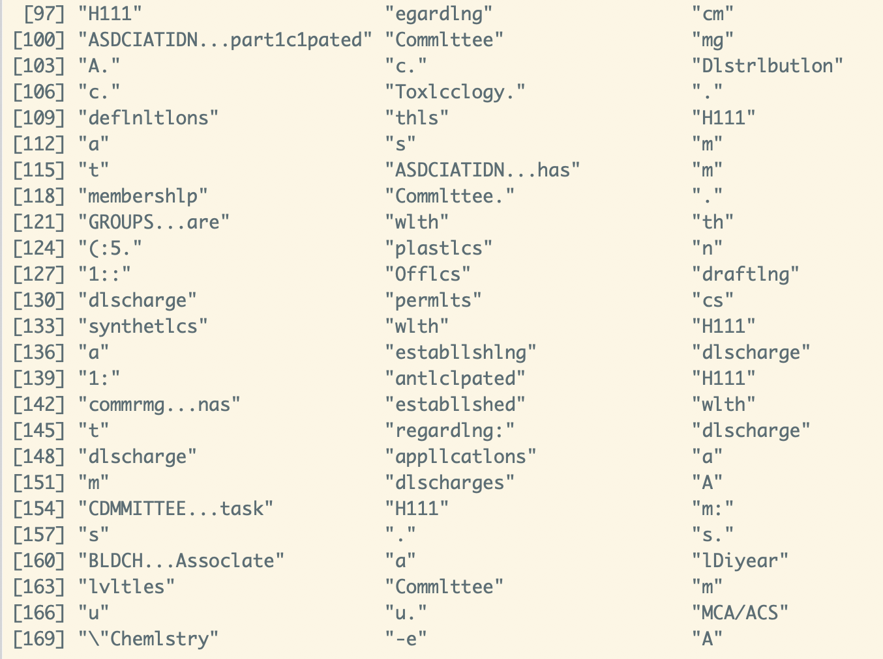
1
Error Detection
Rule-based Techniques
37%
Notes:
group1_00000021 paper：deletion：264candidates，substitution：528， insertion：49

Slide 6
2
Error Correction
C3: Probability scoring without context
Notes:
This paper has focus on errors in the form of typos and spelling errors rather than OCR results.

Slide 7
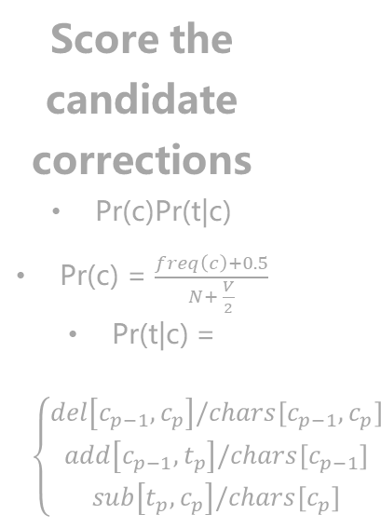
2
Error Correction
Probability scoring without context
STEP 1
STEP 2
STEP 3
STEP 4
Propose candidate corrections:
Insertion
Deletion
Substitution
Reversion
Compare to “Dictionary" to find valid candidate corrections
Score the candidate corrections
Pr(c)Pr(t|c)
Pr(c) = $\frac{freq\left(c\right)+0.5}{N+ \frac{V}{2}}$
Pr(t|c) = $\left\{\begin{aligned}del\left[c_{p−1}, c_{p}\right]/chars[c_{p−1}, c_{p}] \\ add\left[c_{p−1}, t_{p}\right]/chars[c_{p−1}] \\ sub\left[t_{p}, c_{p}\right]/chars[c_{p}]\end{aligned}\right.$
Select the highest score candidate to substitute the error
Notes:
~each candidate correction is scored by the Bayesian combination rule Pr(c)Pr(t|c)
~3 estimation methods: maximum likelihood estimation, expected likelihood estimate, Good-Turing.
~we estimate the prior Pr(c) by ELE.
~where freq(c) is the number of times that the proposed correction c appears in the dictionary made with the vocabulary of ground truth.
N is the total number of words in ground truth files. V is the number of unique words which is the vocabulary size.
~we computed the channel probabilities Pr(t|c) from 3 confusion matrices. Actually here to get better results we’re supposed to compute our own confusion matrices using the ground truth, but it’s very tricky to do so because there are so many other complicated errors in OCR results which causes poor formats so it’s hard to compare the raw texts with their truth and remake the confusion matrix plus we ran out of time so we directly used those confusion matrices in this paper’s appendix.

Slide 8
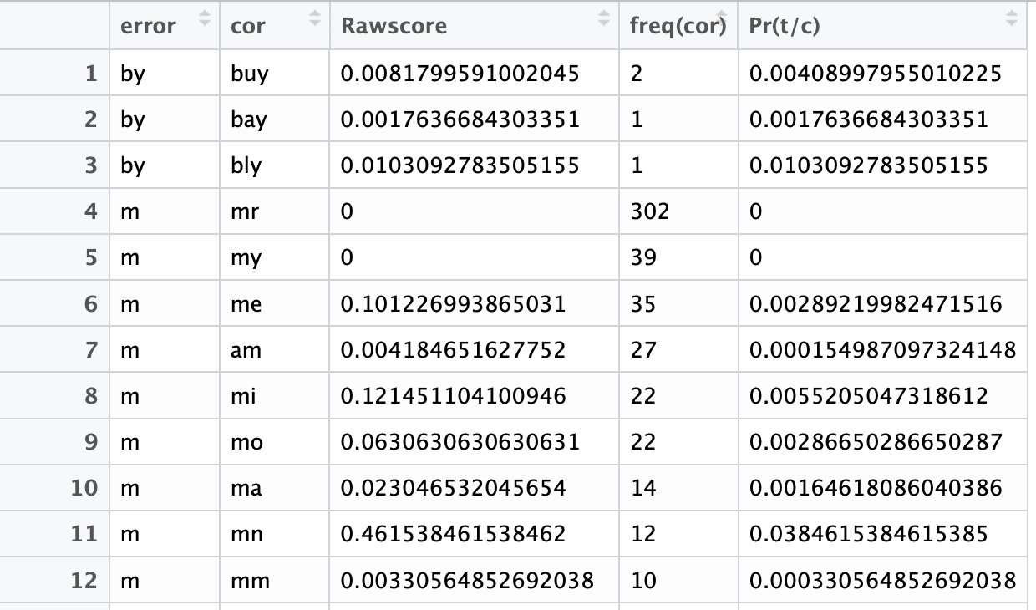
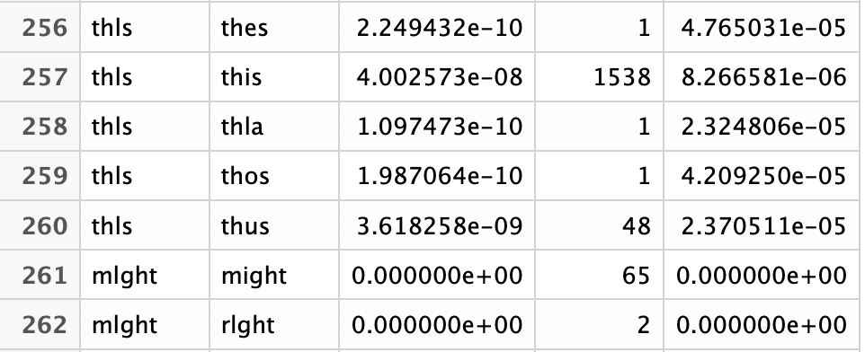
2
Error Correction
Probability scoring without context
点击此处添加标题
点击此处添加标题
Substitution Examples
528
Deletion Examples
264

Slide 9
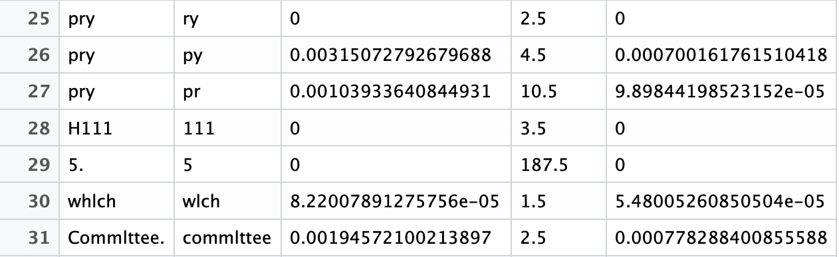
2
Error Correction
Probability scoring without context
Insertion Examples
49

Slide 10
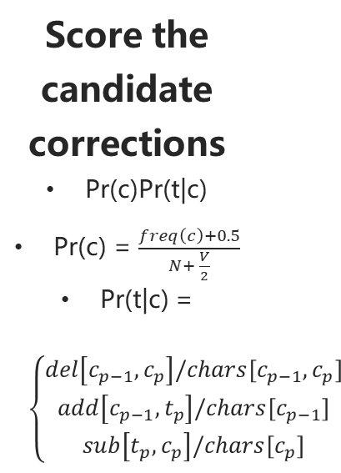
2
Error Correction
Probability scoring without context
STEP 1
STEP 2
STEP 3
STEP 4
Propose candidate corrections:
Insertion
Deletion
Substitution
Reversion
Compare to “Dictionary" to find valid candidate corrections
Score the candidate corrections
Pr(c)Pr(t|c)
Pr(c) = $\frac{freq\left(c\right)+0.5}{N+ \frac{V}{2}}$
Pr(t|c) = $\left\{\begin{aligned}del\left[c_{p−1}, c_{p}\right]/chars[c_{p−1}, c_{p}] \\ add\left[c_{p−1}, t_{p}\right]/chars[c_{p−1}] \\ sub\left[t_{p}, c_{p}\right]/chars[c_{p}]\end{aligned}\right.$
Select the highest score candidate to substitute the error
Notes:
~each candidate correction is scored by the Bayesian combination rule Pr(c)Pr(t|c)
~3 estimation methods: maximum likelihood estimation, expected likelihood estimate, Good-Turing.
~we estimate the prior Pr(c) by ELE.
~where freq(c) is the number of times that the proposed correction c appears in the dictionary made with the vocabulary of ground truth.
N is the total number of words in ground truth files. V is the number of unique words which is the vocabulary size.
~we computed the channel probabilities Pr(t|c) from 3 confusion matrices. Actually here to get better results we’re supposed to compute our own confusion matrices using the ground truth, but it’s very tricky to do so because there are so many other complicated errors in OCR results which causes poor formats so it’s hard to compare the raw texts with their truth and remake the confusion matrix plus we ran out of time so we directly used those confusion matrices in this paper’s appendix.

Slide 11
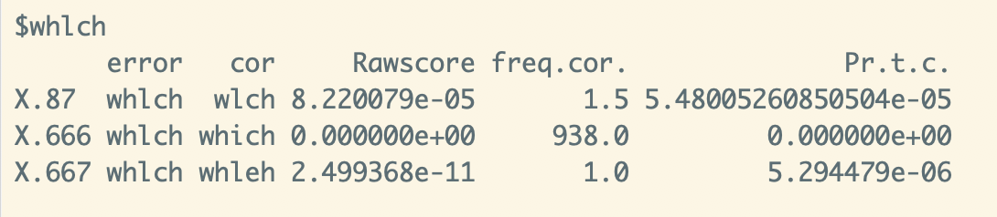
2
Error Correction
Probability scoring without context

Slide 12
3
Evaluation

Slide 13
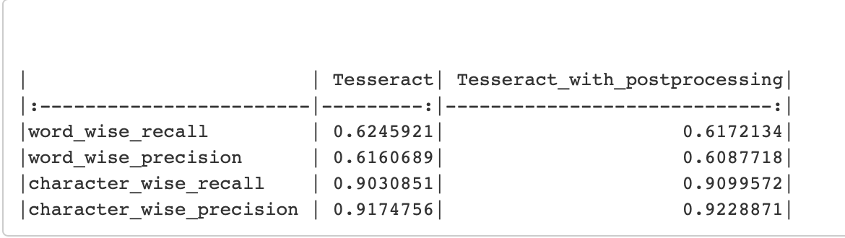
3
Evaluate this system
Notes:
recall is the percentage of words in the original text correctly found by the OCR engine
precision is the percentage of correctly found words with respect to the total word count of the OCR output

Slide 14
4
Problems & Improvement

Slide 15
4
Problems & Improvement
Mismatch the papers
OCR correction
Rules are not rigorous
Contextual constraints
Single character and only character
Study other methods, e.g ngrams, nn
Insufficient dictionary
Larger vocabulary dictionary
Confusion matrix
Calculate by ourselves***

Slide 16
Thank you
Group 9
Jin, Xin xj2215@columbia.edu
Wang, Binhan bw2544@columbia.edu
Wang, Yujia yw3085@columbia.edu
Zhang, Peilu pz2233@columbia.edu
Zhu, Kehui kz2293@columbia.edu

